Slide 1

A Personalised Ad-hoc Ride Sharing App Using Data Analytics
PILLION

Slide 2
TEAM INFORMATION
MEMBER NAME | MOBILE | EMAIL ID | DEPARTMENT
Arvind Kumar.D | 9578458083 | arvind.patricks@gmail.com | CSE
Tamizh Selvan.K | 9629858305 | tamizharunk@gmail.com | CSE
Dayanidhi.D | 8015505579 | dayanidhicse@gmail.com | CSE
Divahar.B | 9500488610 | divahar65@gmail.com | CSE
PROJECT GUIDES
GUIDE NAME | MOBILE | EMAIL ID | DESIGNATION
Dr. J. Madhusudanan | 9003739274 | madhu@smvec.ac.in | Associate Professor
Mr. D. Saravanan | 9865483413 | svsaravana1@smvec.ac.in | Assistant Professor

Slide 3
AGENDA
Personalisation
Why Personalisation is vital in Ride - Sharing
Problem Definition
Current Scenario
Proposed Solution
System Architecture
Interest based Ride - Sharing Algorithm
Calculation of Similarity Score
Development Environment
Deployment Environment
Results & Test Cases
Business Model
Future Scope
References

Slide 4

PERSONALISATION
Making something suitable for the ​needs of a individual
Personalisation is sometimes referred to as one-to-one marketing
Who doesn’t enjoy that feeling of walking into a shop and being recognised, welcomed and treated as an individual?
Personalisation is a means of meeting the customer's needs more effectively and efficiently, making interactions faster and easier and, consequently, increasing customer satisfaction

Slide 5
WHY PERSONALISATION IS VITAL IN RIDE SHARING
The more we know about the riders, the better and more custom-fit services we can provide for them.
By Personalisation, quality and the style of the journey can be enhanced and shift it from traditional customer service to customer-focused service.

Slide 6

PROBLEM DEFINITION
Passengers with different likes & dis-likes find it uneasy while travelling which results for major of them opting out of the ride-sharing.

Slide 7



A Small Survey
A Uber Driver said that he had an issue with his customers because of the language barrier
Uber Driver
A Ola Driver stated that he doesn’t like to hear songs aloud but because of the customers compulsion it makes him an annoyance for him.
Ola Driver
A Bla Bla car App user stated that he had a nuisance with his passenger since he was very talkative.
Bla Bla Car App User

Slide 8
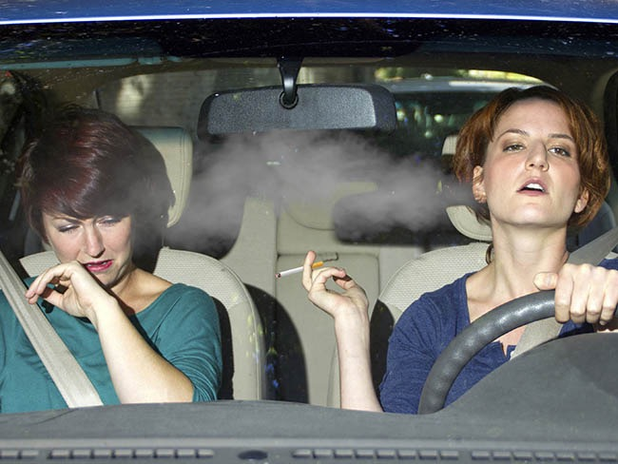
CURRENT SCENARIO
Scenario 1
Non-smoking rider + Smoking Driver = Nuisance!!

Slide 9
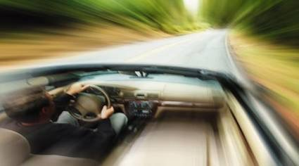
CURRENT SCENARIO
Scenario 2
Speeding Driver + Anxious passenger = Terrible Ride

Slide 10
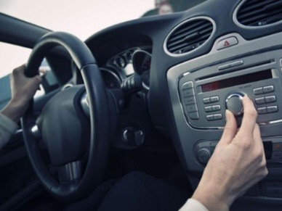
CURRENT SCENARIO
Scenario 3
Rider who likes Rock Music + Rider who likes Blues Music = Boring journey!

Slide 11
PROPOSED SOLUTION
Make the ride-sharing more personalized, ad-hoc and secure.
Personalized rider profile through data collected from social network of users.
Geo-spatial analysis to increase the number of users currently using the Ride-sharing.

Slide 12



PERSONALISED RIDE SEARCH USING USER’S PROFILE
INTERESTS | DISLIKES
A.R.Rahman Songs | Smoking
Travelling | Liquor
Being Social | Rash Driving
Photography | Politics
Sports
INTERESTS | DISLIKES
A.R.Rahman Songs | Smoking
Travelling | Liquor
Nature | Rash Driving
Sports | Politics

Slide 13
PATH TO SOLUTION
Fetch user data from Social Network (With Permission)
Analyse user data using IBM Watson Analytics.
Transform the un-structured data to a structured useful characteristics map of the user through Personality Insights API.
Construct user profile based on interests.
Match the rider with appropriate passenger based on profile.

Slide 14
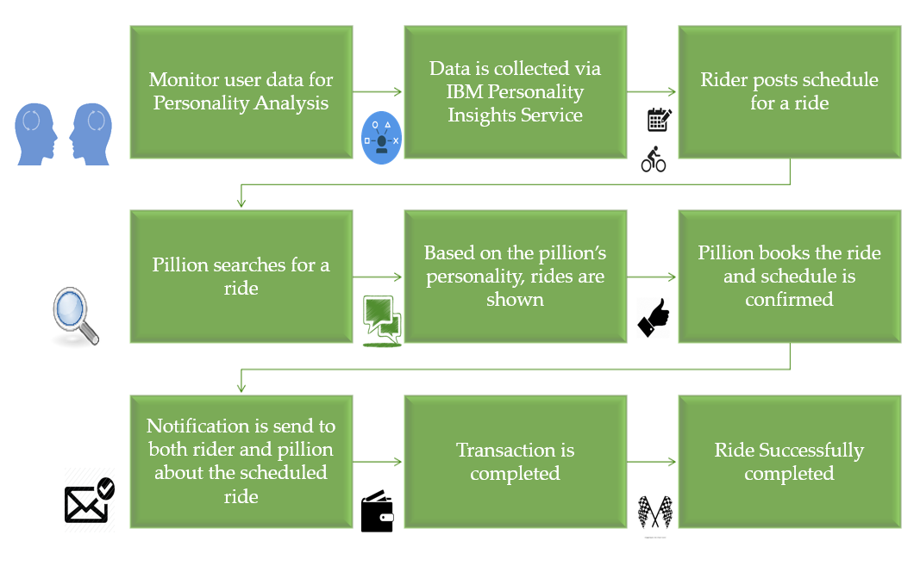
SYSTEM ARCHITECTURE

Slide 15
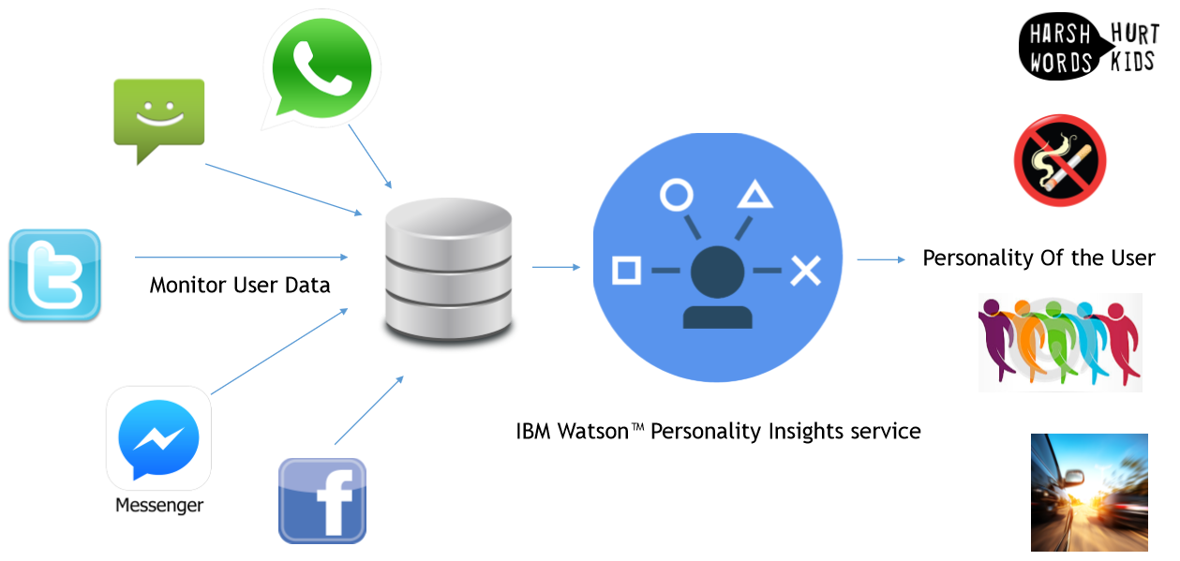
PERSONALISED RIDE SHARING

Slide 16
PERSONALISATION USING DATA ANALYTICS
Personality Insights API from IBM Watson Services
Interest Based Ride Matching Algorithm using Data Analytics

Slide 17
INTEREST BASED RIDE SHARING ALGORITHM
Input : Personality [Pillion], ArrayList<Personality> Users
Step 1 : Calculate Similarity Score
Step 2 : Sort Users Based on Similarity Score
Step 3 : Return ArrayList [Users]
Output : An array list consisting of the User Profiles that are sorted based on the matching characteristics.

Slide 18

CALCULATION OF SIMILARITY SCORE
{
‘id’ : ‘Arvind’,
‘Adventurous’ : 0.91,
‘Openness’ : 0.4,
‘Friendliness’ : 0.65,
‘Emotional’ : 0.7,
‘Trust’ : 0.9
}
{
‘id’ : ‘Tamizh Selvan’,
‘Adventurous’ : 0.95,
‘Openness’ : 0.45,
‘Friendliness’ : 0.70,
‘Emotional’ : 0.7,
‘Trust’ : 0.95
}
ARVIND VS TAMIZH
ADVENTUROUS _DIFFERENCE = (ADVENTUROUS [ARVIND])~ (ADVENTUROUS [TAMIZH])
ADVENTUROUS _DIFFERENCE = (0.91)~ (0.95) = 0.04
SIMILARITY INDEX = 1 - (ADVENTUROUS _DIFFERENCE)
SIMILARITY INDEX = 1 - (0.04)
SIMILARITY INDEX = 0.96
SIMILARTIY PERCENTAGE = (SIMILARITY INDEX) * 100
SIMILARITY PERCENTAGE = (0.96) * 100 = 96%
IF SIMILARITY PERCENTAGE IS GREATER THAN 90 % (i.e) [SIMILARITY PER. > 90%]
SIMILARITY SCORE ++
The users individual similarity scores will be incremented . Based on that the user’s similarity score the user list will be sorted and displayed.

Slide 19
OUTPUT OF IBRS ALGORITHM
NAME OF THE PERSONS | SIMILARITY SCORES
ARVIND Vs TAMIZH SELVAN | 9
ARVIND Vs DAYANIDHI | 7
ARVIND Vs DIVAHAR | 4
ARVIND Vs VENKAT | 2
ARVIND Vs BALA | 1

Slide 20



DEVELOPMENT ENVIRONMENT
MAC OS X
Android SDK
Genymotion Emulator
MINIMUM REQUIREMENTS
Windows 8 (or) Mac OS X Maverick
RAM : 4 GB
Hard Disk Space : 4 GB for SDK
Graphics : 1GB Dedicated Graphics

Slide 21





SERVICES USED
IBM Personality Insights
IBM Visual Insights
IBM Watson Analytics

Slide 22

DEPLOYMENT ENVIRONMENT
ANDROID POWERED MOBILE
Minimum Requirements
Android JellyBean
RAM : 1GB
Free Space : 100 MB
Network : 3G Data

Slide 23
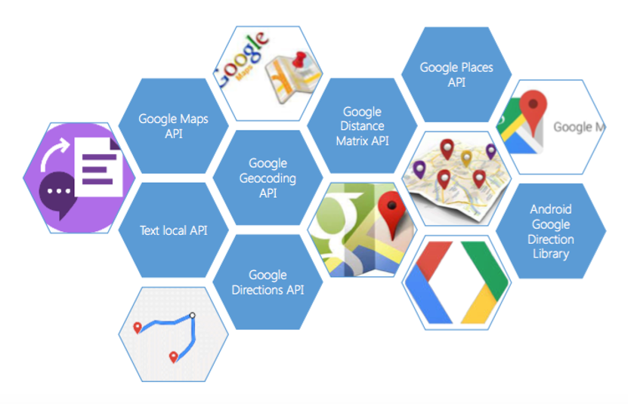
API’S USED

Slide 24
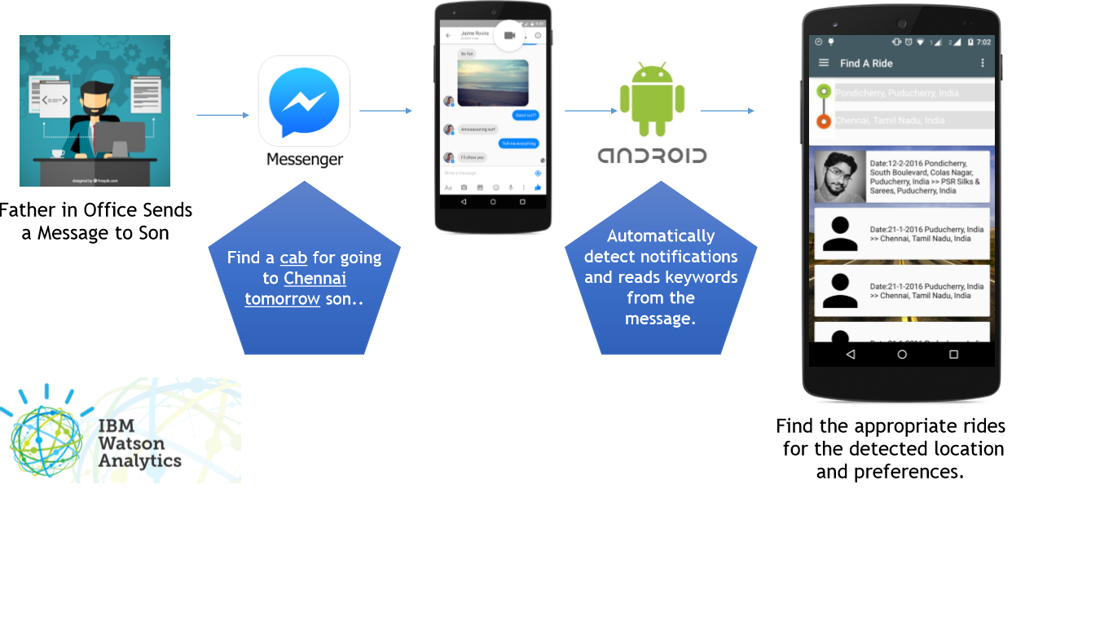
RESULTS & TEST CASES

Slide 25
BUSINESS MODEL
Key Activities
App Development
App Maintenance
Marketing
- End users support
Key Resources
Technological Team
Ride Sharer should have proper skills to drive his/her vehicle
Key Partners
Ride-Sharers with their own cars
Payment Gateway Providers
API Providers
Product Investors
Product Promoters
Channels
Mobile App for Android

Slide 26
BUSINESS MODEL
Value Preposition
Additional source of income for the ride sharer
Prices are less than the normal fares
Co-Passengers don’t need to wait for buses or trains
Easy Payment Procedure
Comfortable travel
Customer Segments
Pillions
People who do not own a car
People who want a cost effective journey
Ride Sharer:
People who want additional source of income
Revenue Streams
Amount is calculated on the basis of Rupees/ Km basis.
Pillions shares the fare - with Rider
Cost Structure
Salaries to development and Maintenance team
Marketing Expenditure

Slide 27
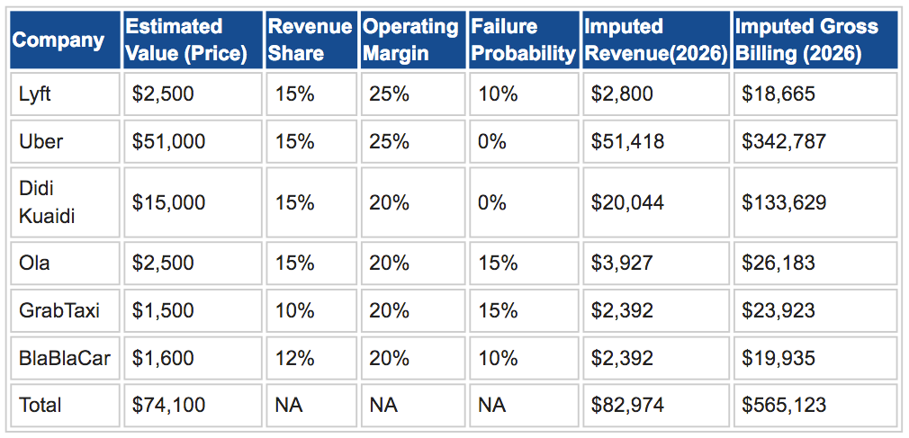
BUSINESS MODEL

Slide 28


FUTURE SCOPE
Users will find it easy if the ride finding is done via voice recognition through speech-to-text API.
Speech-To-Text API
Searching for a ride using a pic of a tourist location using Google Image Search
Google Image Search

Slide 29
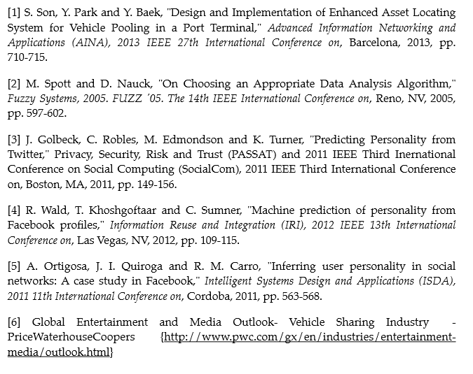
REFERENCES

Slide 30
DEMO
TIME

Slide 31
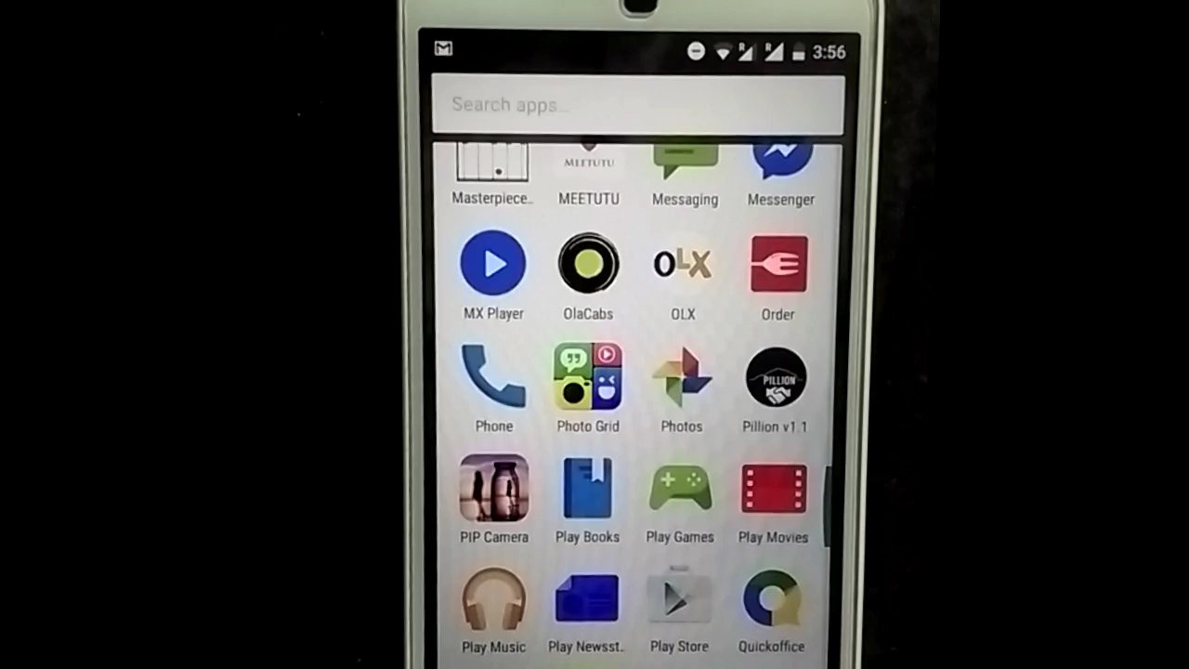
PILLION ADVERTISEMENT

Slide 32
Question & Answers

Slide 33

THANK YOU

